Slide 1

20CSD302 Mini Project First Review
SAINTGITS
COLLEGE OF ENGINEERING
(AUTONOMOUS)
LEARN . GROW . EXCEL

Slide 2
Project Area : Web Development Project Topic : OrderByte
SAINTGITS
COLLEGE OF ENGINEERING
(AUTONOMOUS)
Supervisor
Name: Er.Thomas Joseph
Designation: Assistant Professor
Presented By
Merlyn Mary Stephen - 23
Rinny Anna Thomas - 41
Shalin Ann Thomas - 53
Sneha Mariam Samuel - 61
LEARN . GROW . EXCEL

Slide 3

Contents
Introduction
Literature Review
Objectives
Workflow
Use Case Diagram
Implementation
Modules
Timeline
Project Progress
Limitations
Conclusions
Reference
LEARN . GROW . EXCEL

Slide 4
Introduction
OrderByte, is a web-based platform designed to:
Allow end users to preorder meals and make payments online, ensuring their selected meals are reserved and ready for collection.
Enhance the food service experience by eliminating the need to wait in long queues, making the process more efficient and convenient.
LEARN . GROW . EXCEL

Slide 5
Literature Review
Sl.No | Title | Authors & Publications | Techniques Used and Observations
1. | E-Canteen Management System based on Web Application | Lalitha V., Magesh K., Selvanarayanan A., Keertheshwaran G. | Introduces a web-based canteen management application. Enhances operational efficiency by streamlining order processing and transaction management. Reduces manual errors and waiting times in canteen queues.
2. | The Design of Nutrition Ordering System without Queuing in the College Canteen | Zhang X., Li Y., Wang J. | Proposes a nutrition-focused food ordering system. Aims to minimize queuing issues in college canteens. Provides an advanced web interface that allows students to customize their meal options based on nutritional requirements
LEARN . GROW . EXCEL

Slide 6
Literature Review
Sl.No | Title | Authors & Publications | Techniques Used and Observations
3. | The Website-Based Food Booking System Equipped with Real-Time Booking Status to Address Queuing Issues at Restaurants | M. R. Ardiansyah, J. F. Kusuma, I. S. Gumelar, M. Mentari | Implements a real-time booking system for food orders. Designed to address excessive queuing at restaurants, adaptable for canteen management. Features live booking status updates to ensure users know the availability of dishes.
4. | Canteen Automation System with Payment Gateway | Avhad P., Bhanushali H., Bhatt K., Rathod M. | Combines canteen management with automated payment systems. Provides integration with online payment gateways for seamless transactions. Aims to enhance customer convenience and reduce the scope for manual billing errors.
LEARN . GROW . EXCEL

Slide 7
Literature Review
Sl.No | Title | Authors & Publications | Techniques Used and Observations
5. | MERN-Based Canteen Management System: IoT Integration for RFID Payment and Table Reservation | Gosalia J., Dhande S., Naiksatam A. | Utilizes the MERN stack (MongoDB, Express.js, React.js, Node.js) for efficient system development. Integrates IoT devices for RFID-based payments, ensuring contactless transactions. Provides features like table reservations and pre-ordering to optimize user experience. Focuses on scalability and modular design for future enhancements.
LEARN . GROW . EXCEL

Slide 8
Objectives
Reduce Canteen Congestion and Decrease Waiting Times by implementing a system for preordering and online payments.
Ensure Meal Availability for end users through advanced prebooking options.
Provide a User-Friendly Online Ordering Platform for seamless meal selection and payment.
Enhance Canteen Service Efficiency by enabling staff to prepare meals ahead of time.
Offer Support to Parents and Visitors with an effortless meal ordering process during college visits.
Encourage the Adoption of Digital Payment Solutions to optimize the ordering and payment system.
LEARN . GROW . EXCEL

Slide 9
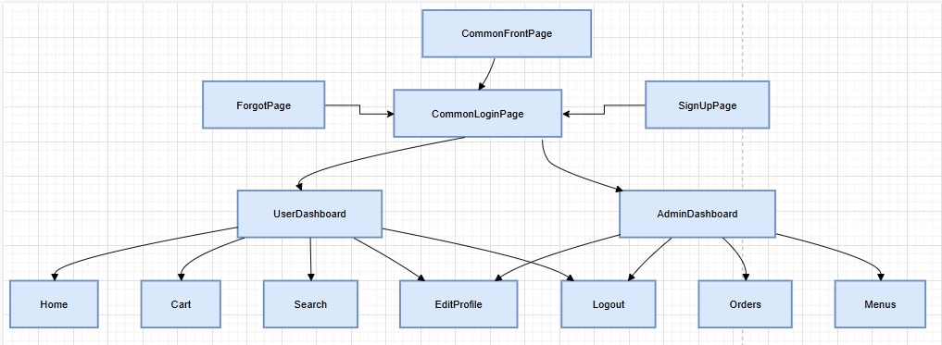
Workflow
LEARN . GROW . EXCEL

Slide 10
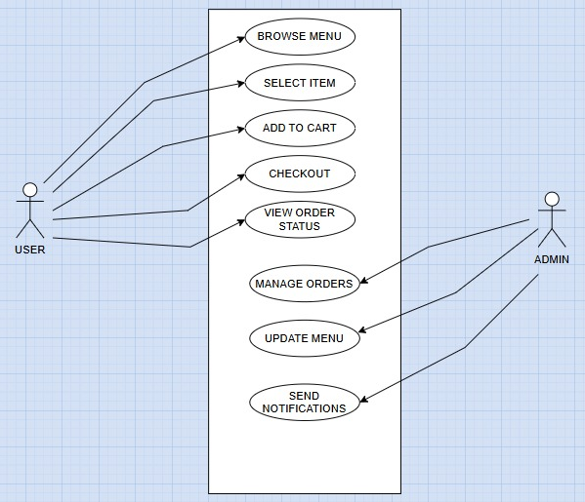
Use Case Diagram
LEARN . GROW . EXCEL

Slide 11
Implementation
Logins: It consists of a sign-in page, a sign-up page and an admin page
Frontend Development: HTML, CSS, JavaScript
Backend Development: Python Flask, Firebase
LEARN . GROW . EXCEL

Slide 12
Modules
USER MODULE
Login and Security
Allows new users to sign up using email and password.
Allows new users to sign in using email and password.
If users forget their password, they can reset their password.
Home
Presents a complete menu, organized by category such as breakfast, lunch, drinks, etc.
Shows whether the item is available or not.
LEARN . GROW . EXCEL

Slide 13
Modules
Search and Filter
Users can find menu items through keyword search.
Users can refine their search using various filters.
Cart
Enables users to add, remove items and adjust their quantities.
Enables users view their selected items.
Redirects users to a secure payment gateway for easy transaction.
User Profile Management
Enables users to add, remove items and adjust their quantities.
Enables users view their selected items.
Redirects users to a secure payment gateway for easy transaction.
LEARN . GROW . EXCEL

Slide 14
Modules
ADMIN MODULE
Order Management
Allows admins to view and filter orders.
Allows admins to track order status and update them as completed, pending, or rejected.
Menu Management
Enables admins to add, edit menu items, and adjust their quantities.
Profile Management
Enables admins to update the details of the users.
Allows the admins to track the orders of the users.
LEARN . GROW . EXCEL

Slide 15
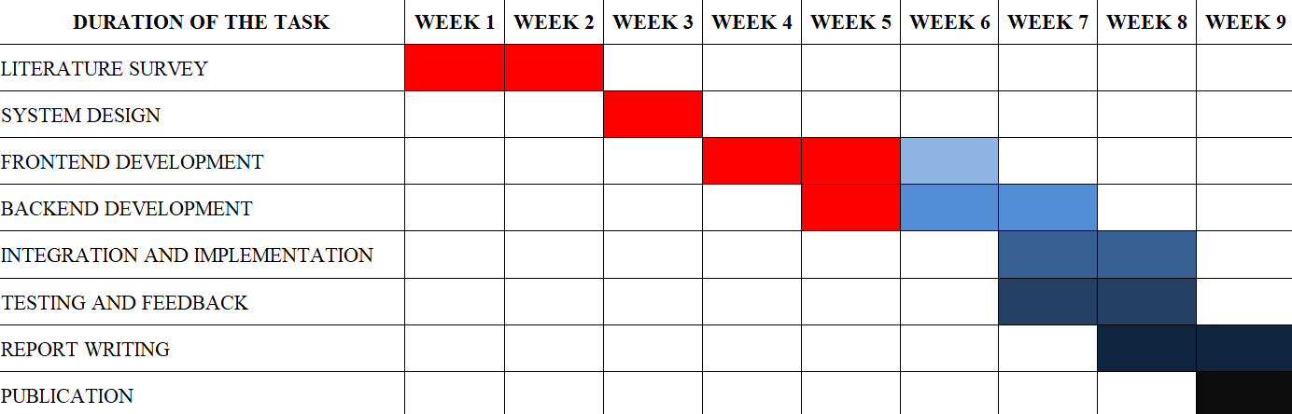
Timeline
LEARN . GROW . EXCEL

Slide 16
Project Progress
Frontend and login pages are complete. Currently working on backend development and payment gateway integration.
LEARN . GROW . EXCEL

Slide 17
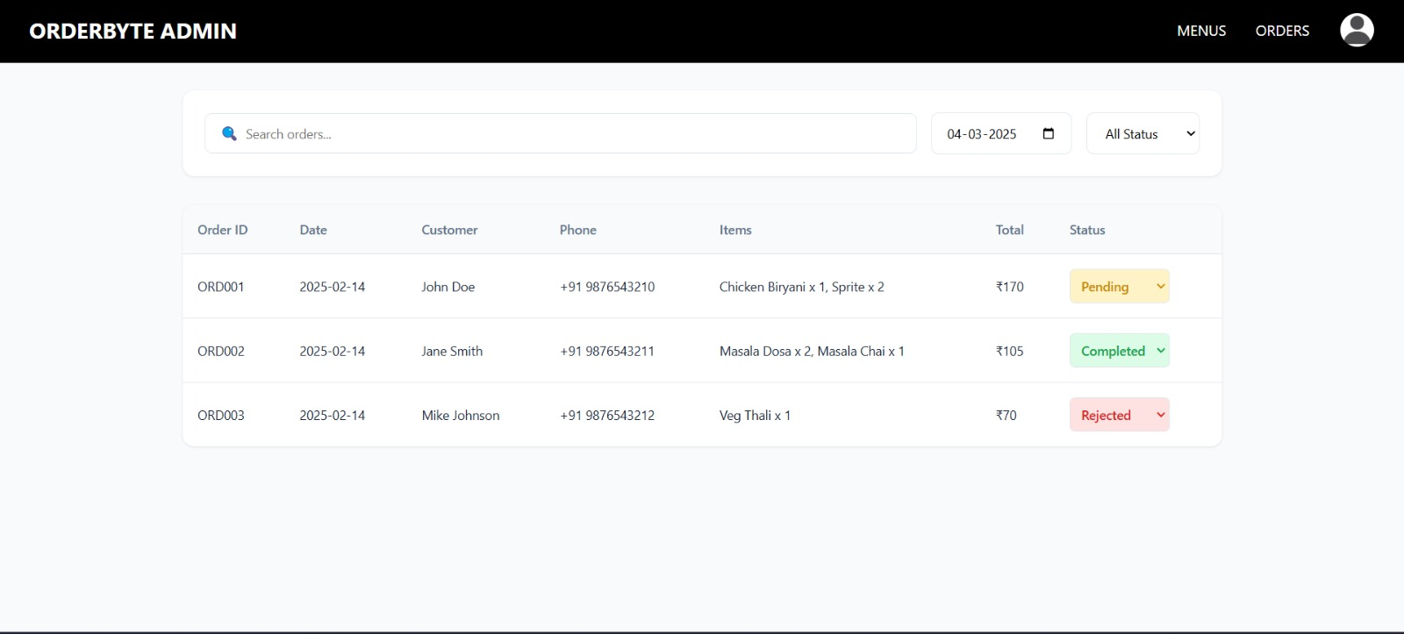
Admin Order Page
LEARN . GROW . EXCEL

Slide 18
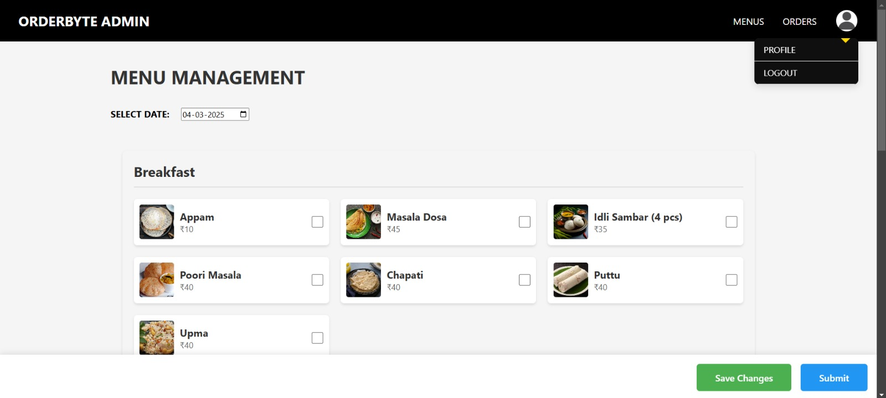
Admin Menu Page
LEARN . GROW . EXCEL

Slide 19
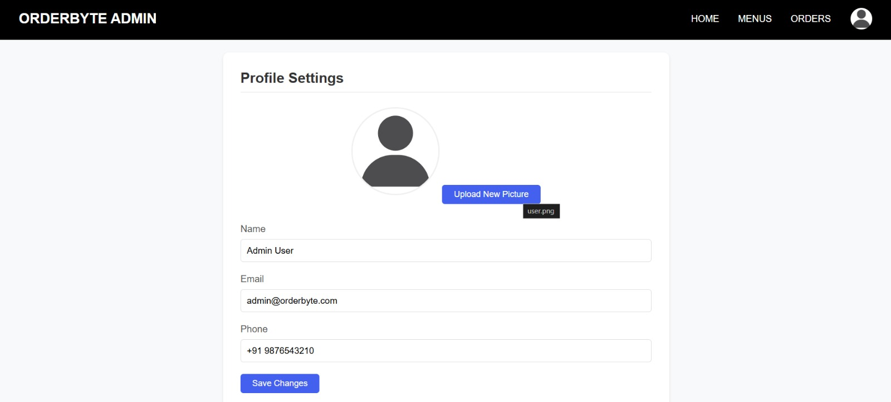
Admin Edit Profile Page
LEARN . GROW . EXCEL

Slide 20
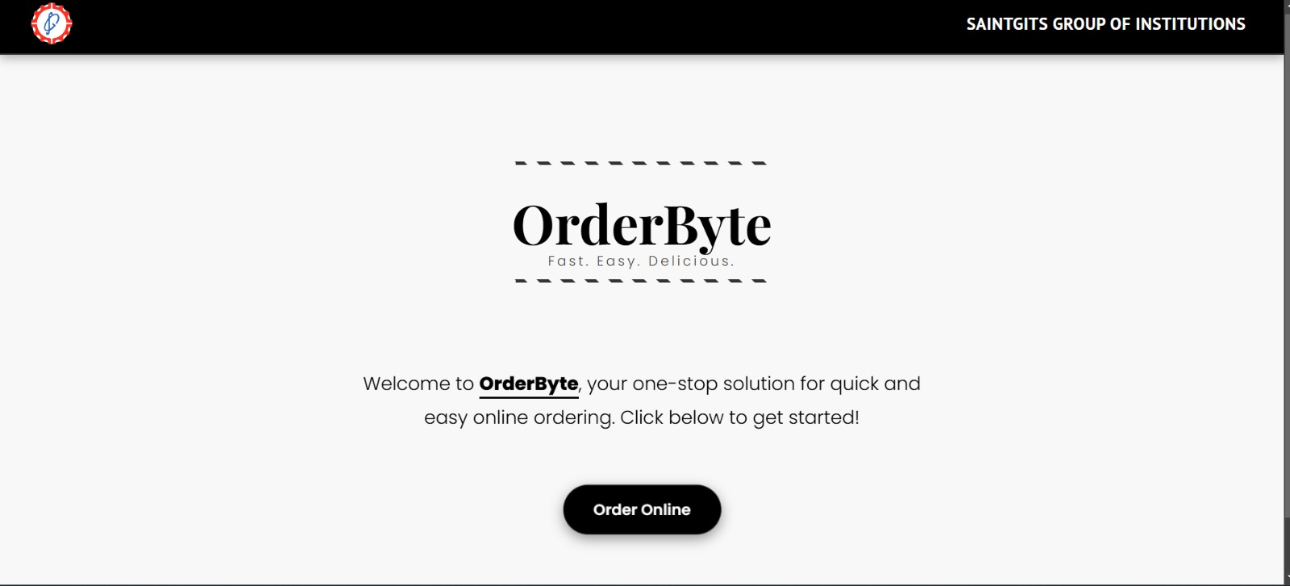
Index Page
LEARN . GROW . EXCEL

Slide 21
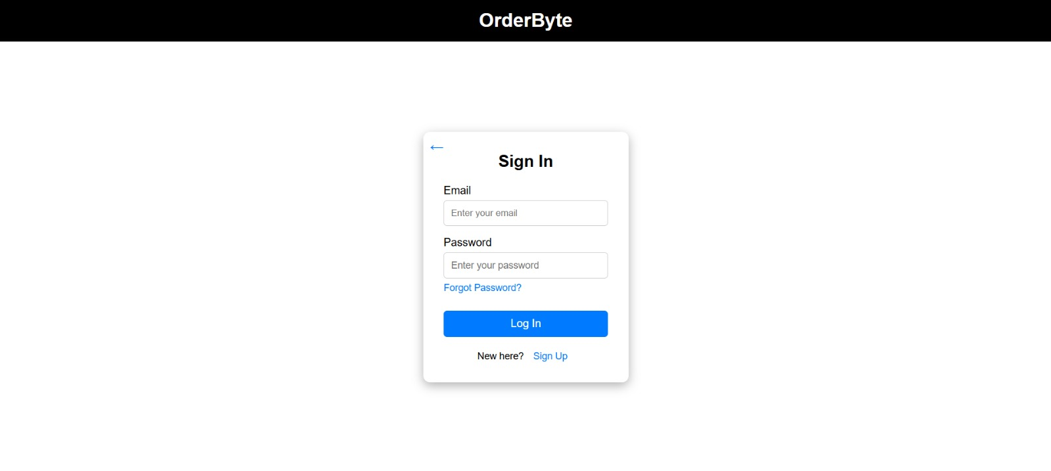
Sign-In Page
LEARN . GROW . EXCEL

Slide 22
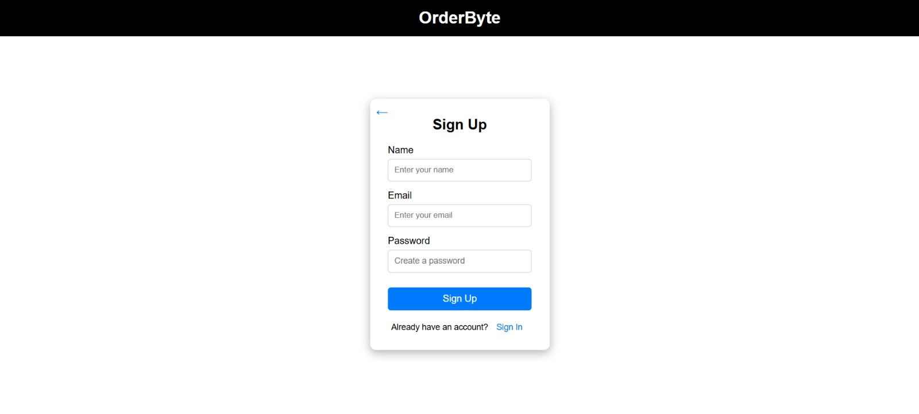
Sign-Up Page
LEARN . GROW . EXCEL

Slide 23
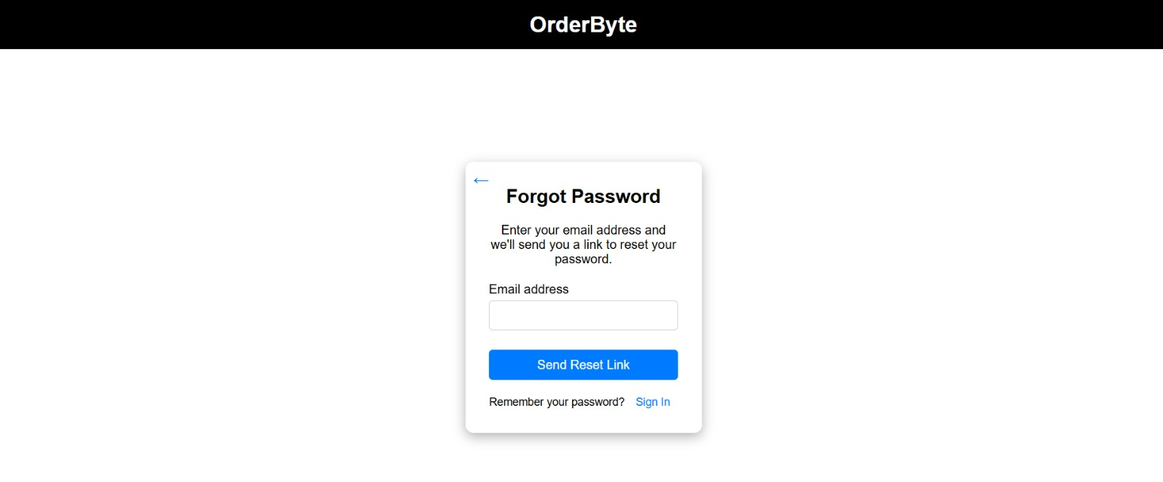
Forgot Password Page
LEARN . GROW . EXCEL

Slide 24
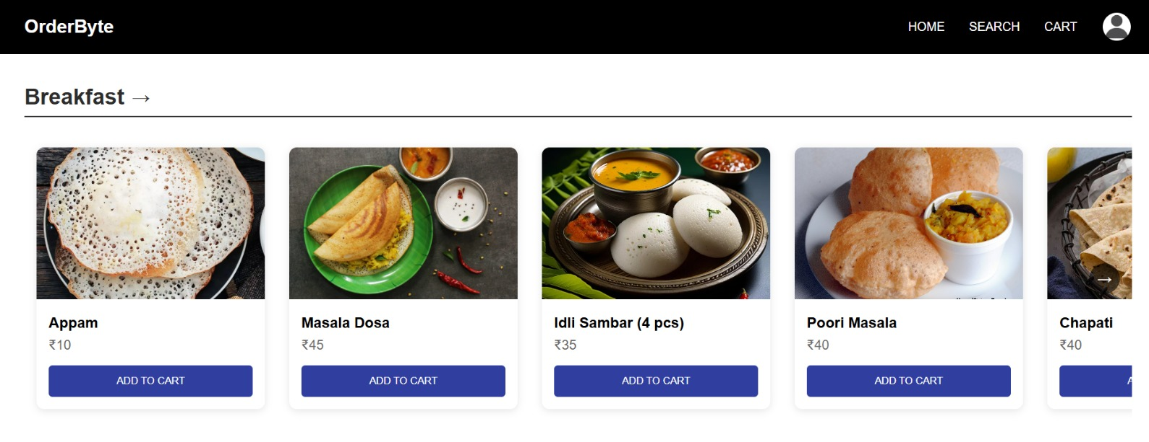
User Home Page
LEARN . GROW . EXCEL

Slide 25
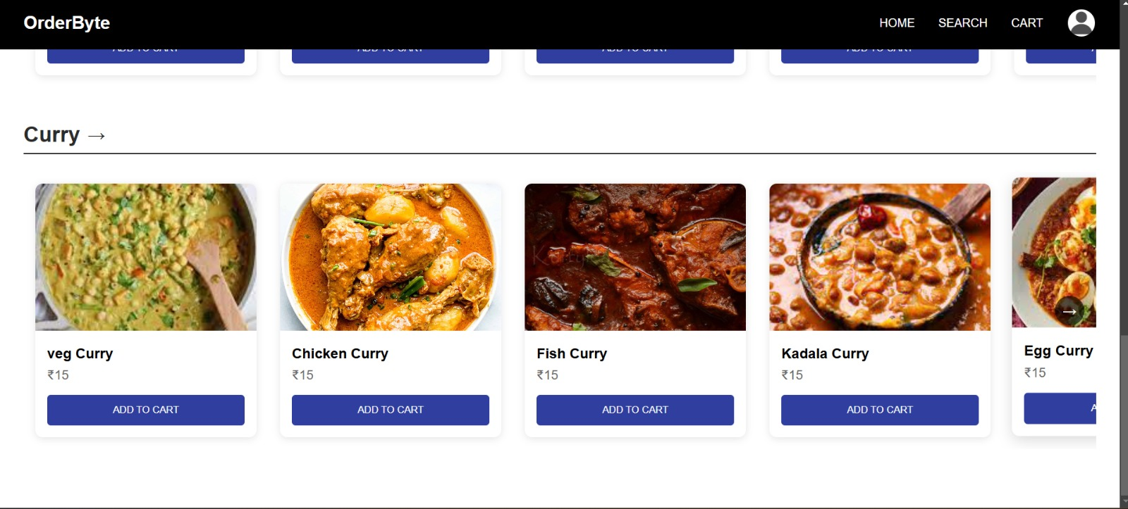
User Home Page
LEARN . GROW . EXCEL

Slide 26
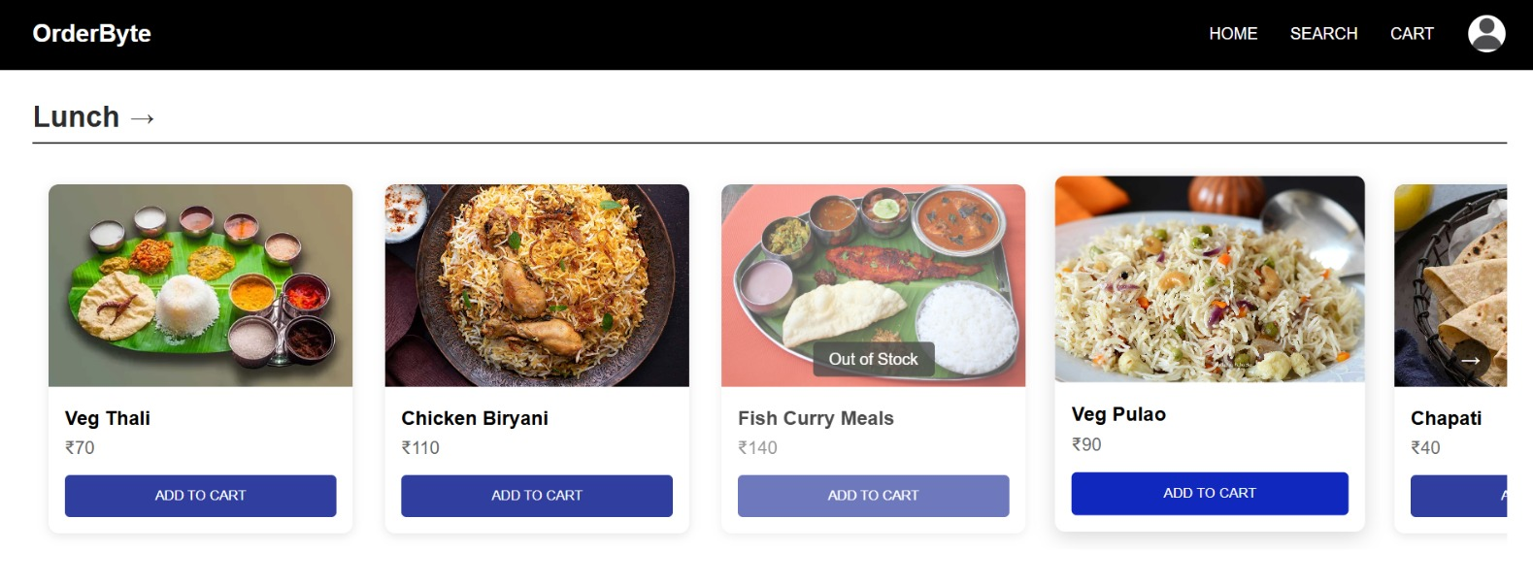
User Home Page
LEARN . GROW . EXCEL

Slide 27
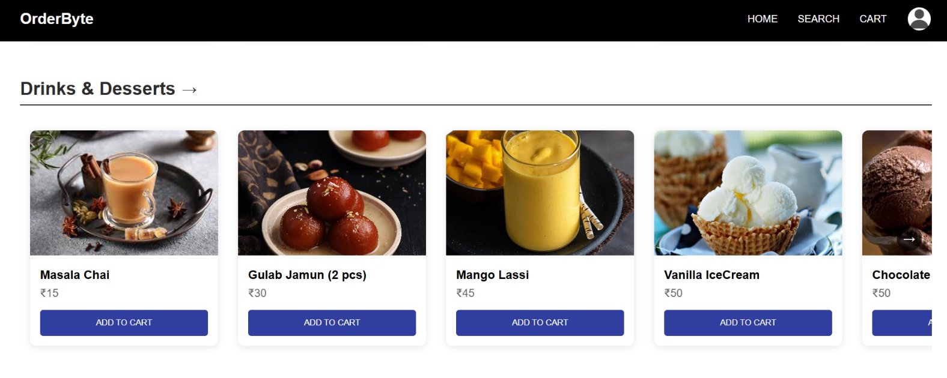
User Home Page
LEARN . GROW . EXCEL

Slide 28
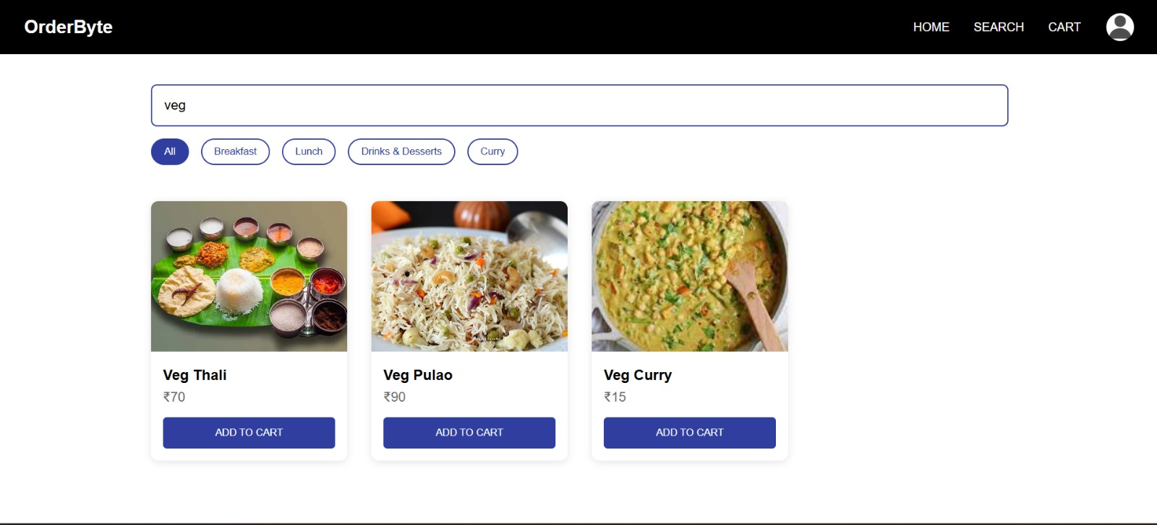
Search Page
LEARN . GROW . EXCEL

Slide 29
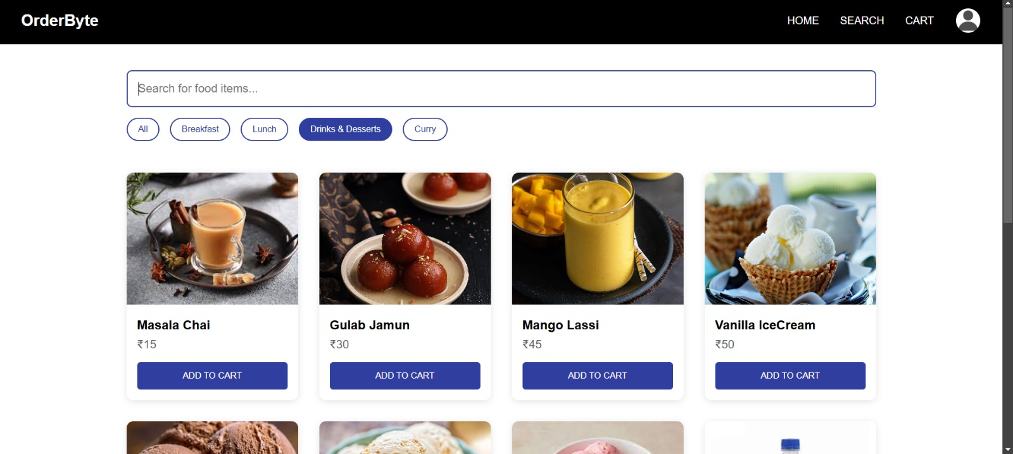
Search Page
LEARN . GROW . EXCEL

Slide 30
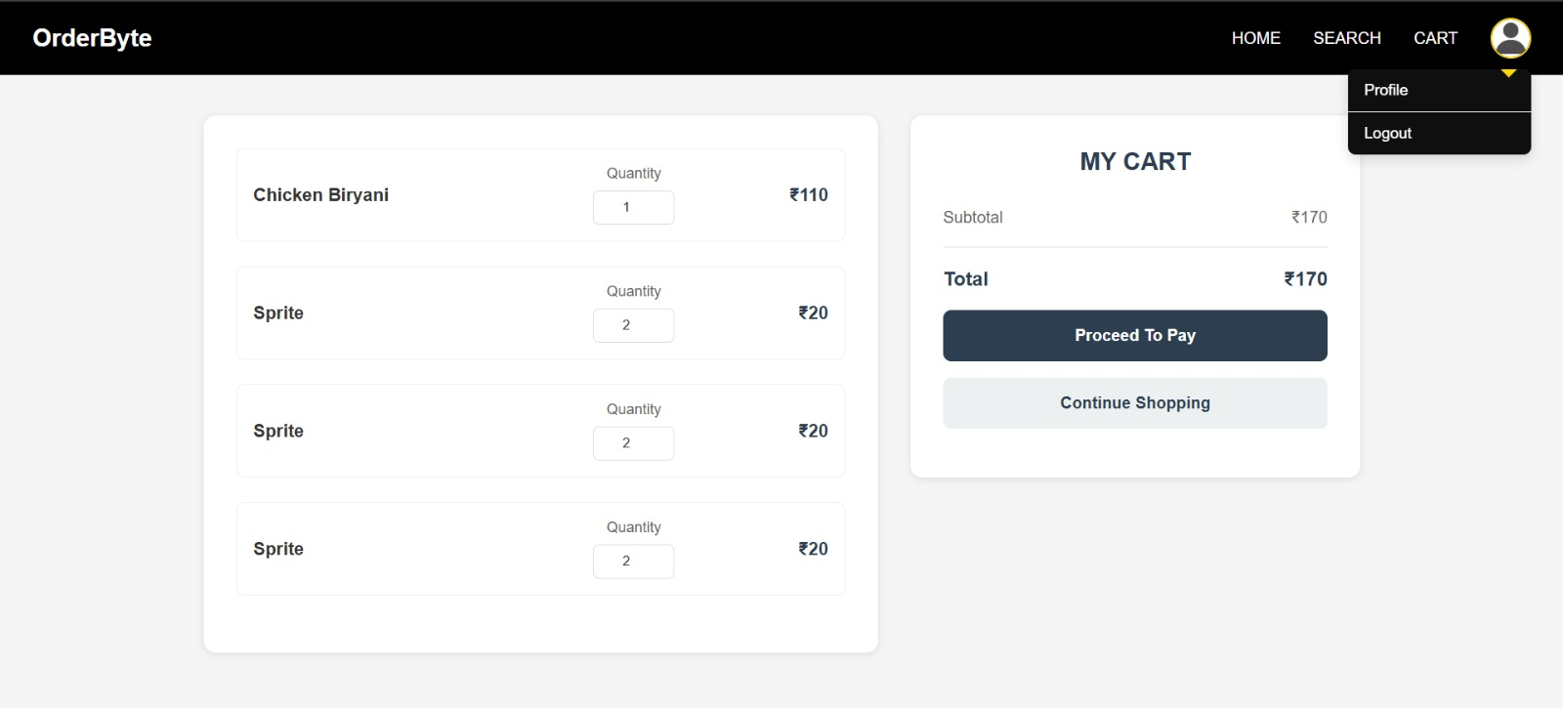
Cart Page
LEARN . GROW . EXCEL

Slide 31
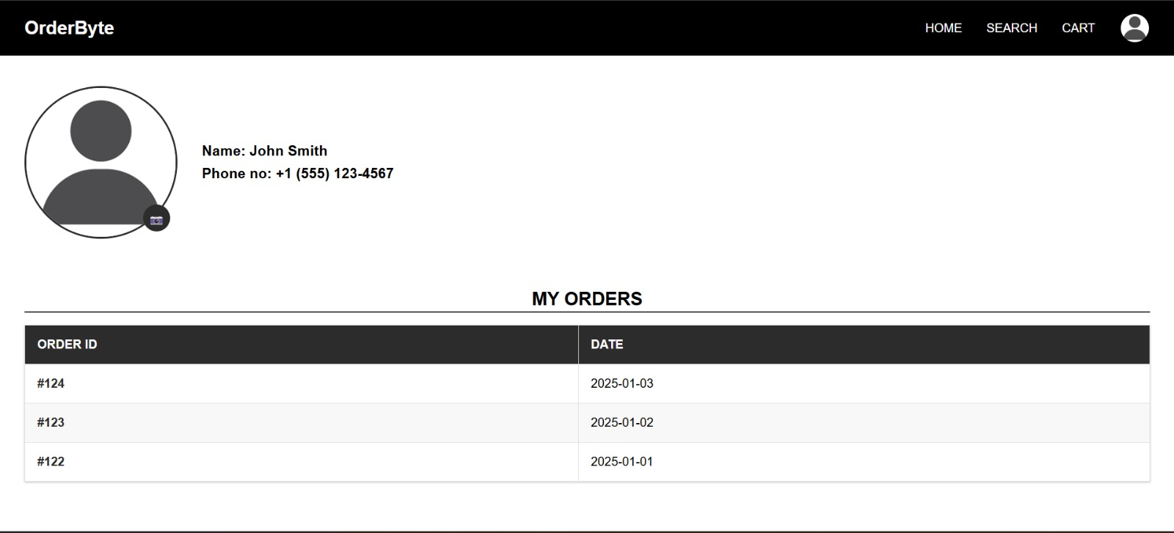
User Profile Order History Page
LEARN . GROW . EXCEL

Slide 32
Limitations
Internet Dependency: Requires a stable internet connection for seamless operation.
Initial Setup Cost: Implementing the system may involve high initial costs for hardware and software.
Technical Issues: System failures, bugs, or downtime can disrupt canteen operations.
Limited Customization: The system may not cater to specific dietary preferences or sudden menu changes.
Scalability Challenges: As the number of users increases, response times may slow down.
LEARN . GROW . EXCEL

Slide 33
Conclusion
Preorder Booking: Allows users to book meals in advance, reducing wait times.
Minimizing Food Crowding: Efficient meal scheduling prevents overcrowding.
Enhancing Canteen Operations: Streamlined processes improve service efficiency.
Punctual & Well-Organized System: Ensures timely meal preparation and delivery.
Customer-Friendly Experience: Reduces hassle and enhances user satisfaction.
LEARN . GROW . EXCEL

Slide 34
References
Lalitha V., Magesh K., et al., "E-Canteen Management System," IC3IoT, IEEE, vol. 15, no. 4, pp. 45-50, Aug. 2022.
Zhang X., Li Y., Wang J., "Nutrition Ordering System," SmartTech J., IEEE, vol. 9, no. 2, pp. 20-25, Feb. 2020.
M. R. Ardiansyah, J. F. Kusuma, I. S. Gumelar, M. Mentari, "Website-Based Food Booking System," TechXplore, IEEE, vol. 12, no. 3, pp. 31-40, Mar. 2021.
Avhad P., Bhanushali H., Bhatt K., Rathod M., "Canteen Automation System," Int. J. Comput., IEEE, vol. 7, no. 1, pp. 12-19, Jan. 2022.
Gosalia J., Dhande S., Naiksatam A., "MERN-Based Canteen Management System," IoT & Cloud Comput., IEEE, vol. 13, no. 4, pp. 56-62, Dec. 2020.
LEARN . GROW . EXCEL

